Slide 1

Rockbuster Company Strategy
Tammy Sique
January 2023

Slide 2
Purpose of Analysis
Key Questions and Objectives
Rockbuster is transitioning from being a physical store to an online rental service in order to to compete with other streaming resources
This analysis will provide information about our current customers and standing
Which countries are Rockbuster customers based in?
Which movies contributed the most/least to revenue gain?
What was the average rental duration for all videos?
Where are customers with a high lifetime value based?
Do sales figures vary between geographic regions?

Slide 3
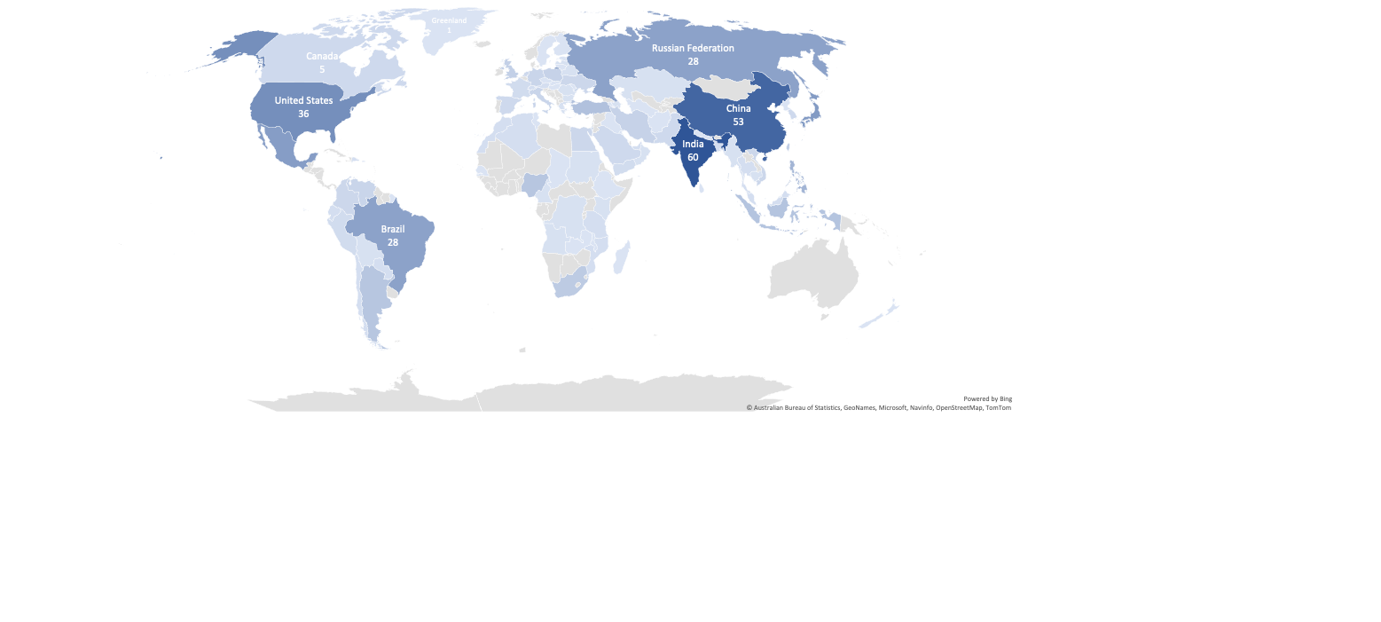
Rockbuster Worldwide Customers
Total Customers:
599
Notes:
Hover over countries for customer count

Slide 4
Movie revenue
Top 10 movies
Title | Rating | Genre | Total Payment
Telegraph Voyage | PG | Music | $216
Zorro Ark | NC-17 | Comedy | $200
Wife Turn | NC-17 | Documentary | $199
Innocent Usual | PG-13 | Foreign | $192
Hustler Party | NC-17 | Comedy | $191
Saturday Lambs | G | Sports | $191
Titans Jerk | PG | Sci-Fi | $187
Harry Idaho | PG-13 | Drama | $178
Torque Bound | G | Drama | $170
Dogma Family | G | Animation | $169
Last 10 movies
Title | Rating | Genre | Total Payment
Texas Watch | NC-17 | Horror | $6
Oklahoma Jumanji | PG | New | $6
Duffel Apocalypse | G | Documentary | $6
Freedom Cleopatra | PG-13 | Comedy | $6
Rebel Airport | G | Music | $7
Young Language | G | Documentary | $7
Treatment Jekyll | PG | Drama | $7
Cruelty Unforgiven | G | Classics | $7
Lights Deer | R | Classics | $8
Stallion Sundance | PG-13 | Sci-Fi | $8
The top and last 10 movies give us a glance as to which ratings and genres are being viewed.
We will continue to look at genres to know better which are being viewed more frequently.

Slide 5
Rental Revenue
Genre Revenue
Genre | Rental Revenue
Sports | $125,547
Animation | $124,972
Action | $118,563
Family | $116,842
Sci-Fi | $116,128
Rental Duration
Number of Titles | 1000
Minimum | 3
Maximum | 7
Average | 5

Slide 6
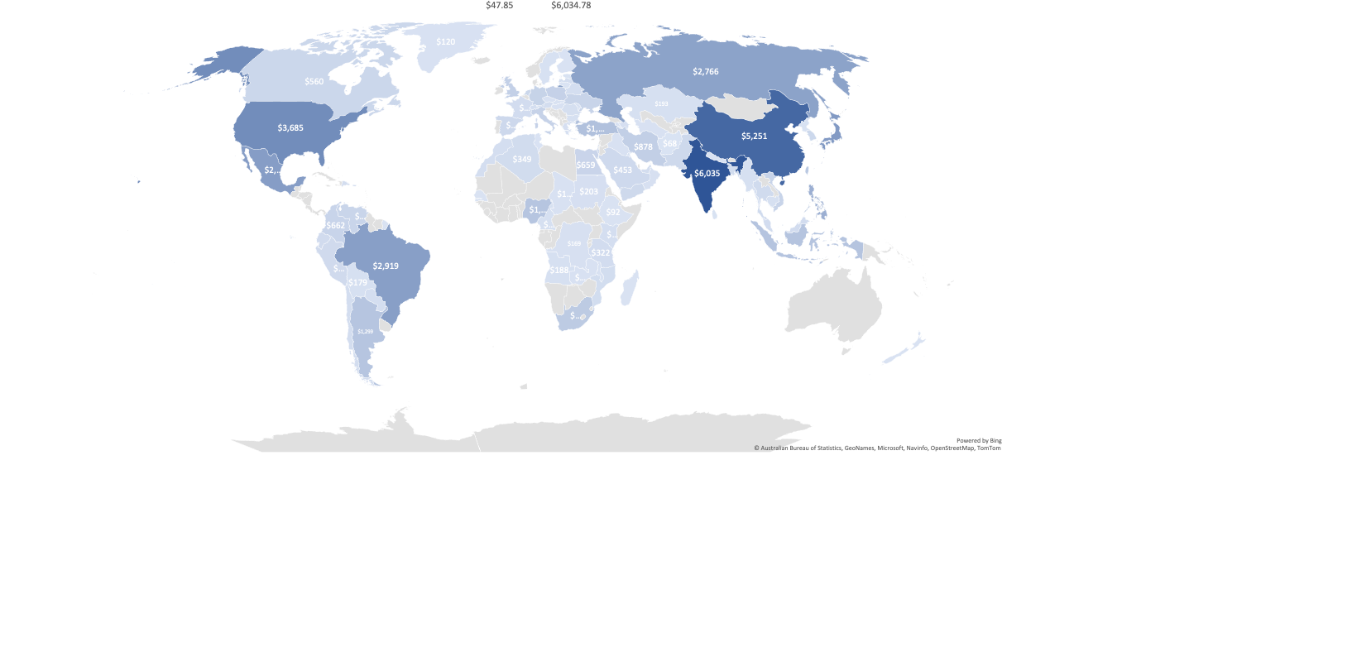
Rockbuster Worldwide Revenue

Slide 7
Top Charts
Top 10 Countries
Country | Customer Count | Total Payment
India | 60 | $6,035
China | 53 | $5,251
United States | 36 | $3,685
Japan | 31 | $3,123
Mexico | 30 | $2,985
Brazil | 28 | $2,919
Russian Federation | 28 | $2,766
Philippines | 20 | $2,220
Turkey | 15 | $1,498
Indonesia | 14 | $1,353
SUM | 315 | $31,834
Top 5 customers
Country | City | Total Paid
Mexico | Atlixco | $129
Turkey | Sivas | $109
Mexico | Celaya | $103
United States | Aurora | $99
India | Adoni | $98
The top 10 countries show us where most of the revenue and customers are located. The top 5 customers come from one of the top 10 countries, which gives us insight not only who, but where we should be focusing on.

Slide 8
Suggestions
Focus on top 5 countries:
1
India, China, United States, Japan, and Mexico
Advertise top genres:
2
Sports, animation, action, family, and sci-fi
Provide incentives to customers
3
Discount to top 5 customers
Yearly subscription will be 20% off
Begin a referral program
One free month for each person who uses the customers referral code
Additional Analysis
4
Launch a formal customer segmentation based on data we already have then A/B test it

Slide 9
Questions
tsique@gmail.com

